Slide 1

Understanding The Progression Of Oral Cancer

Slide 2
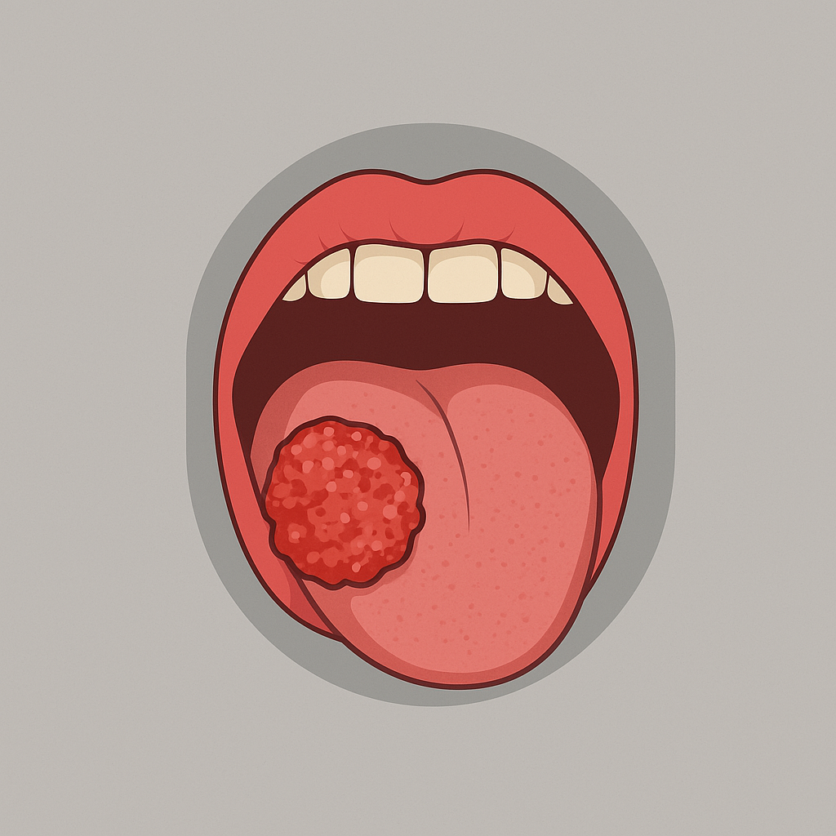
Project Objective
Research Importance
We aim to analyze how demographic, clinical, and lifestyle factors influence oral cancer outcomes including tumor size, cancer stage, survival rate, and economic burden.
Oral cancer remains a significant global health challenge. Early diagnosis and targeted treatment could improve survival and reduce costs. This research helps identify where those improvements can happen.
Our Research Focus Area
Data Cleaning And Preprocessing
Age and gender differences
Impact of HPV status
Effect of treatment types (surgery, chemo, radiation, etc.)
Economic burden: cost of treatment and lost workdays
Tumor size and cancer stage dynamics
Checked for missing values and visualized them using a heatmap
Identified and removed duplicate records
Standardized column names
Fixed data types for accurate analysis
Handled outliers using statistical techniques to ensure reliability
Explored summary statistics to understand distributions and central tendencies

Slide 3
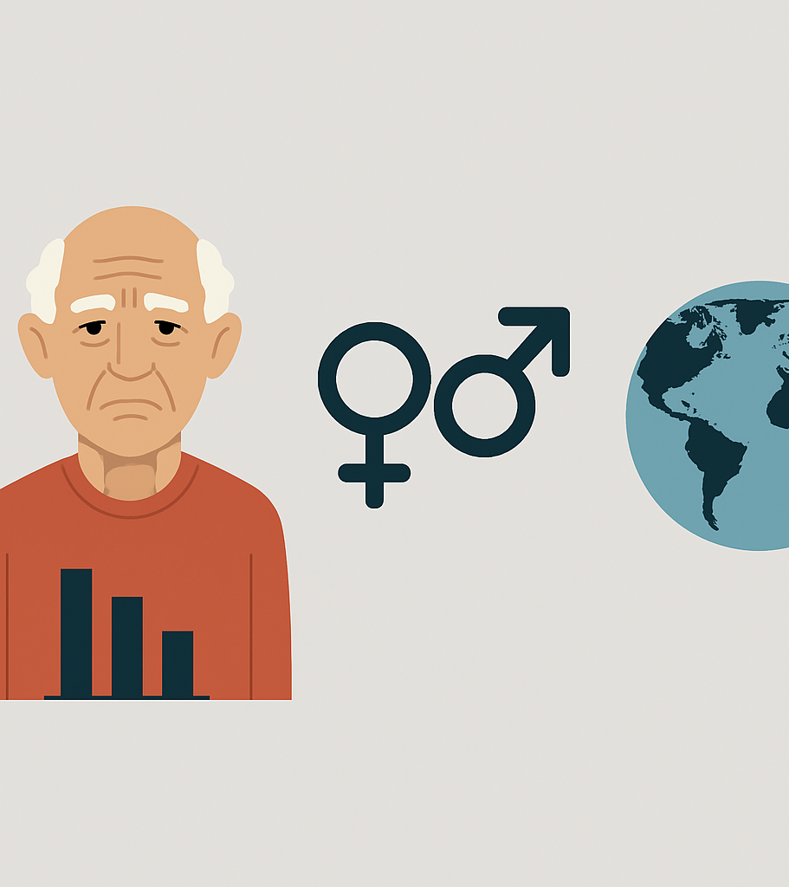
How do demographic factors influence the likelihood of developing oral cancer?
Research Question 1
Factors considered:
Age
Gender
Country

Slide 4
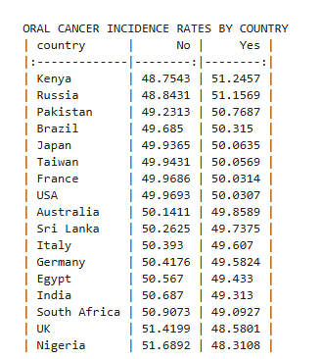
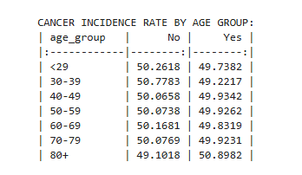
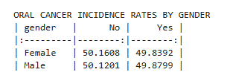
Demography and Oral Cancer
Descriptive Statistics
Oral cancer prevalence increases slightly with age, shows negligible gender differences, and varies by country, with Kenya and Russia having the highest rates.

Slide 5
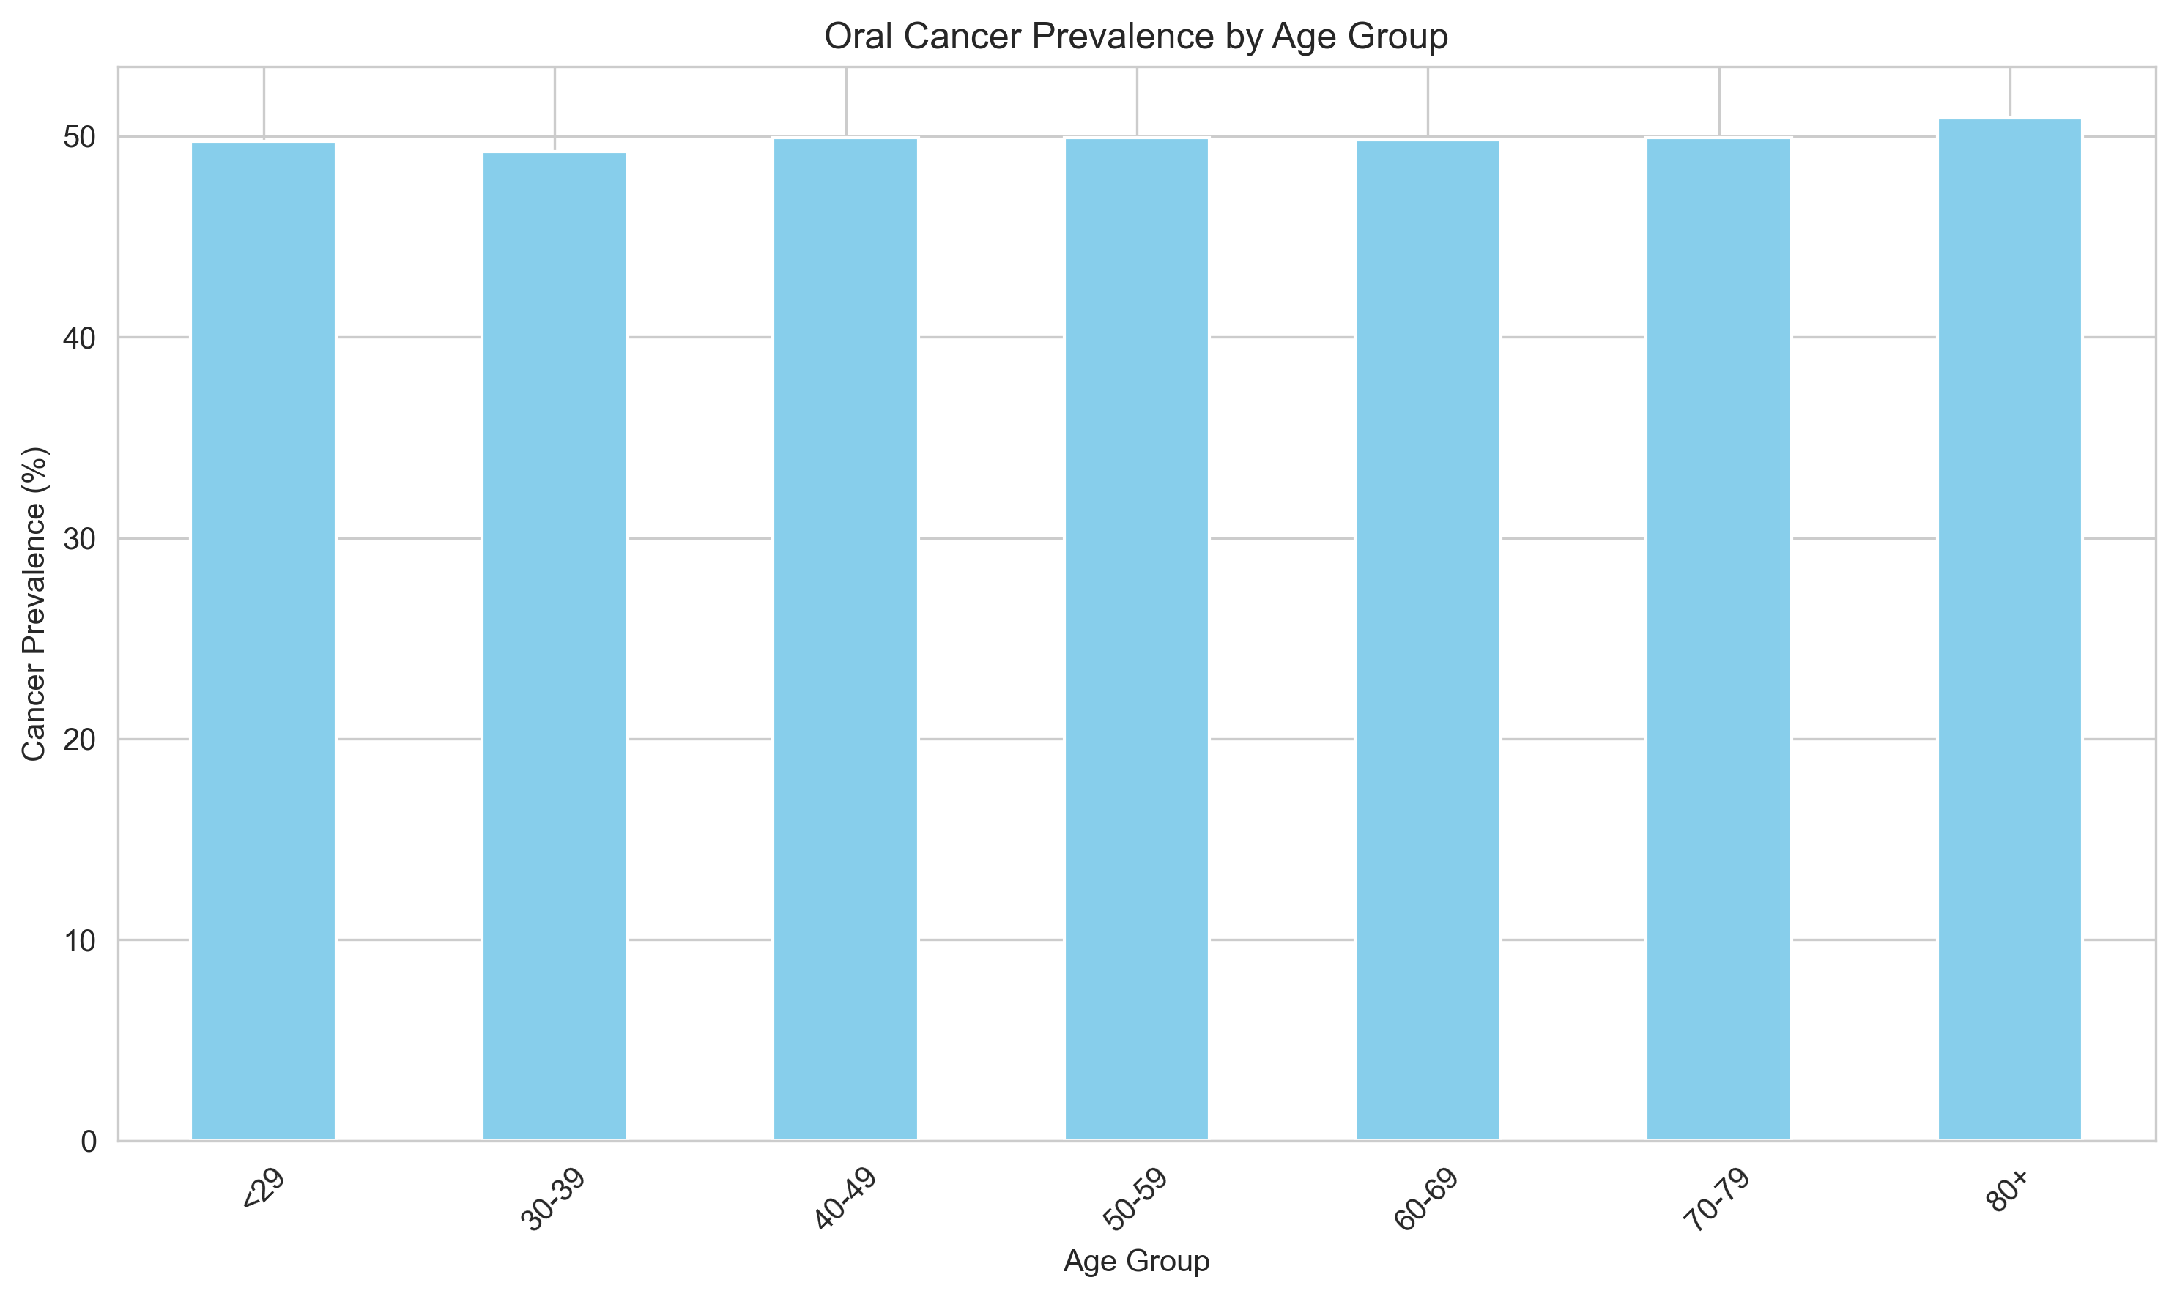
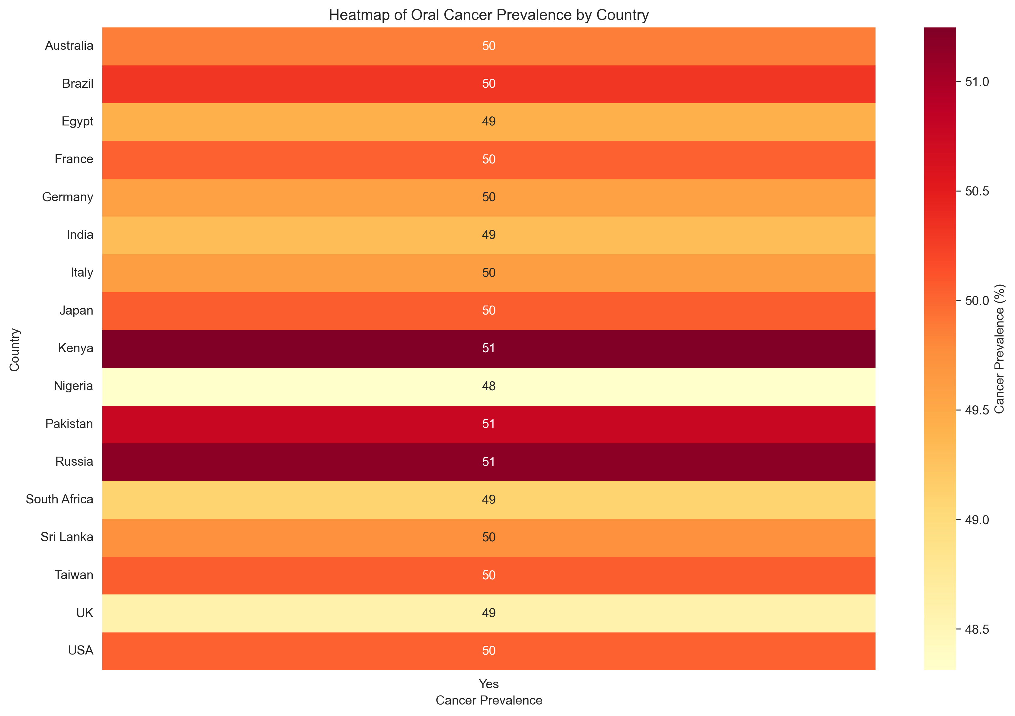
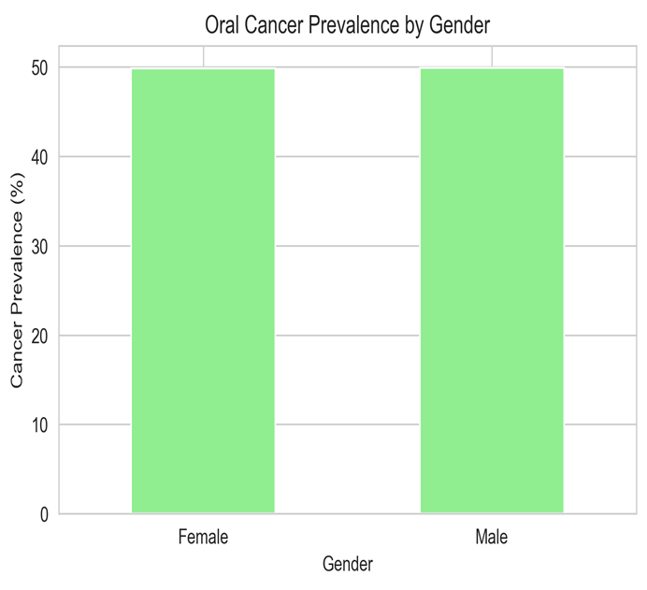
Demography and Oral Cancer
Visualization

Slide 6
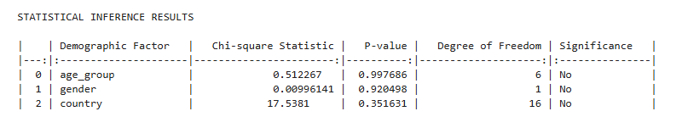
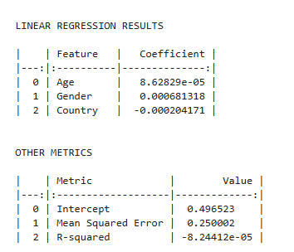
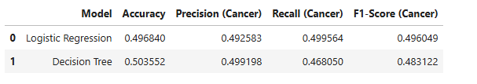
Demography and Oral Cancer
Statistical Inference
Linear Regression
Predictive Data Mining - Classification
These analyses collectively suggest that while demographic factors (age, gender, and country) are associated with oral cancer incidence, they alone aren't strong enough predictors. Additional factors like lifestyle, genetics, or environmental exposures may enhance predictive accuracy significantly.

Slide 7

Research Question 2
What are the most significant predictors of oral cancer diagnosis among the given risk factors?

Slide 8
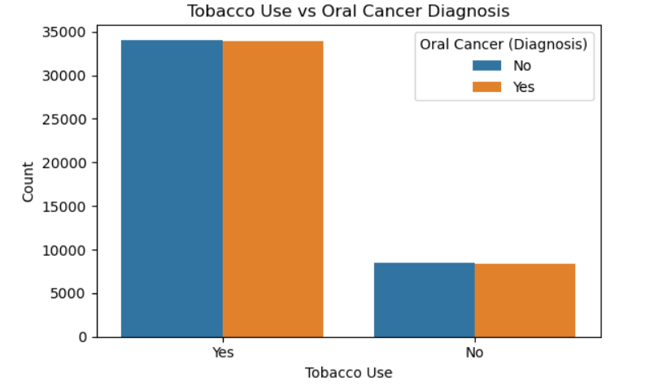
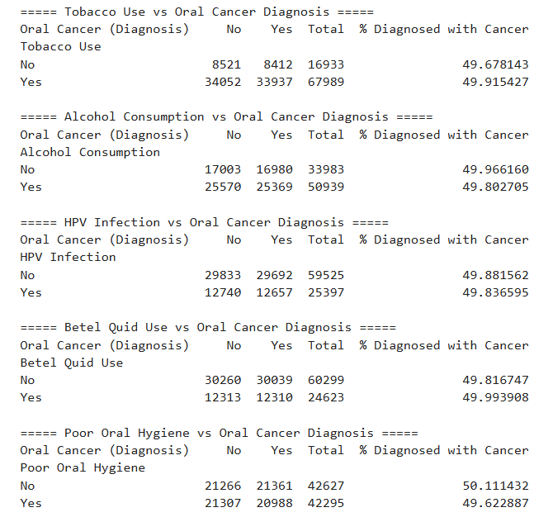
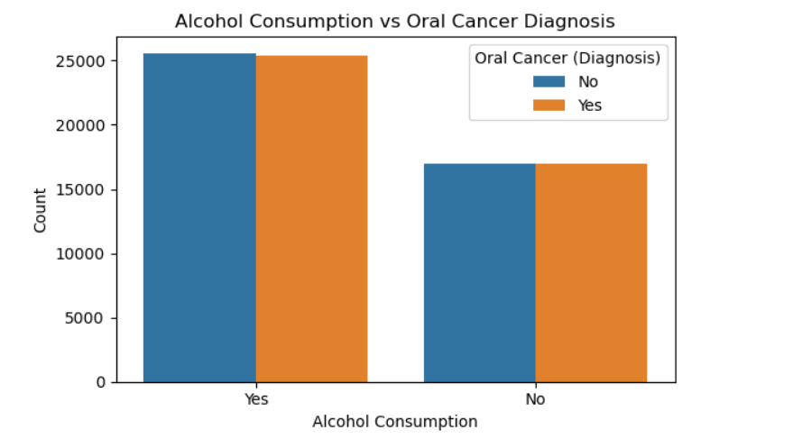
Descriptive Statistics And Visualizations
The tobacco use, alcohol consumption, and HPV infection showed significantly higher oral cancer diagnosis rates among individuals who answered "Yes."
Tobacco users had a diagnosis rate of over 50%.
A stacked bar chart clearly illustrated this trend, showing that high risk behaviors were strongly associated with higher diagnosis rates.

Slide 9
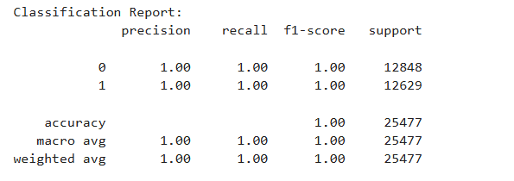
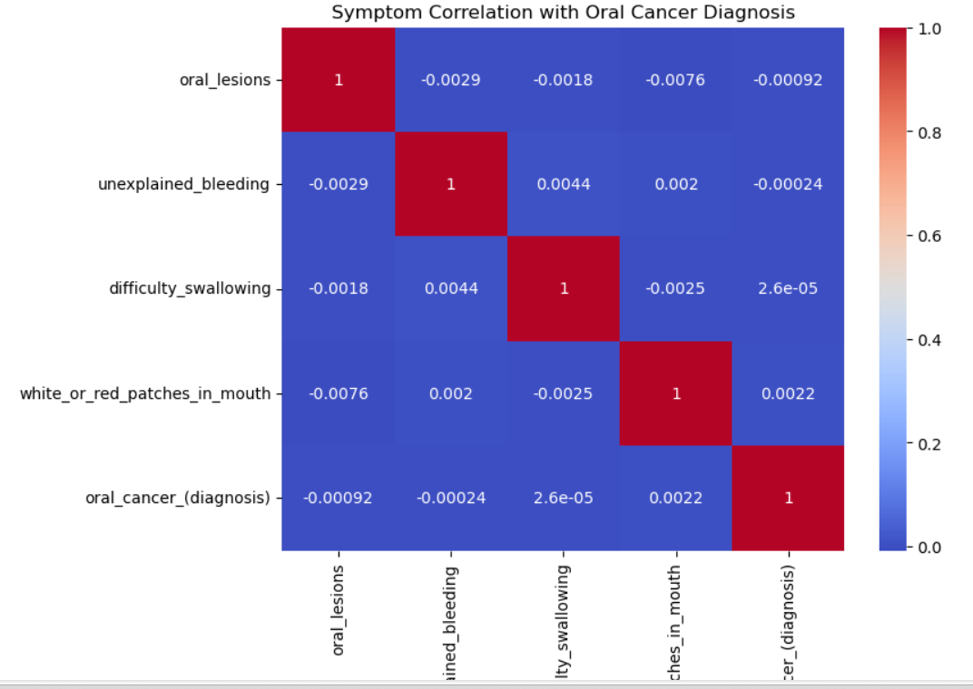
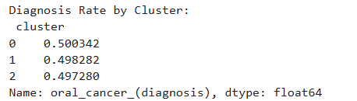

Logistic Regression
Descriptive Data Mining
Statistical Inference

Slide 10

How Do Early Diagnosis and Treatment Type Impact Survival Rates and Economic Burden Among Oral Cancer Patients?
Research Question 3

Slide 11
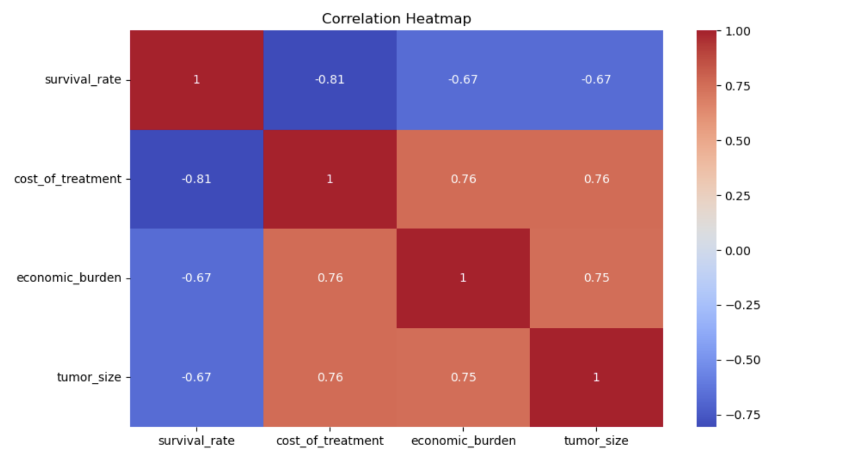
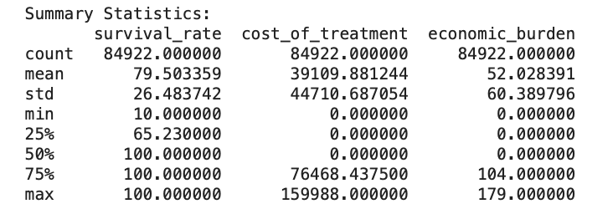
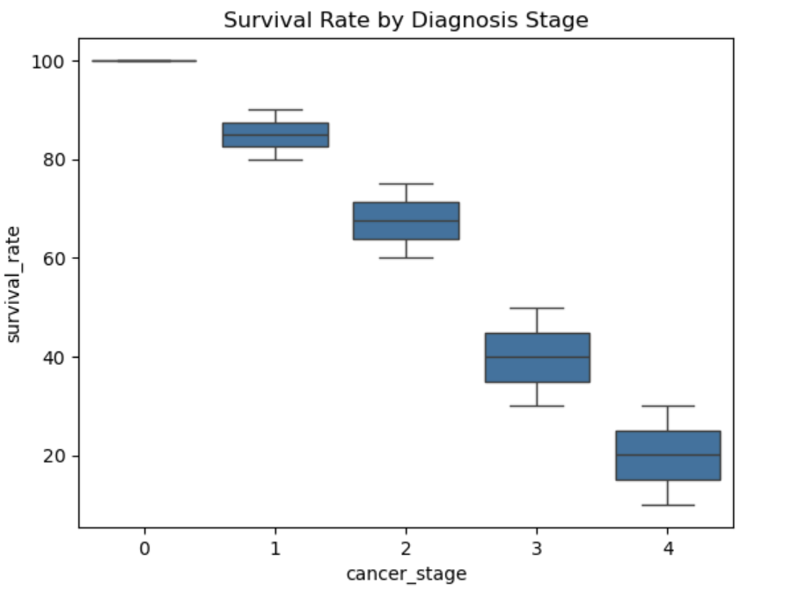
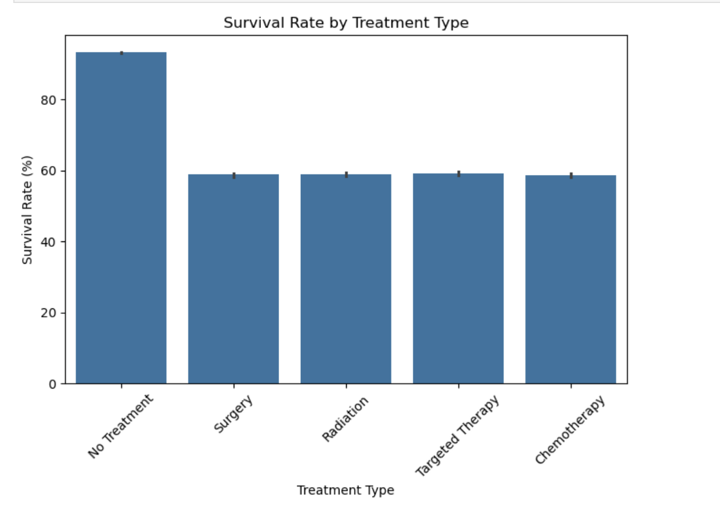
Descriptive Statistics
Data Visualizations

Slide 12
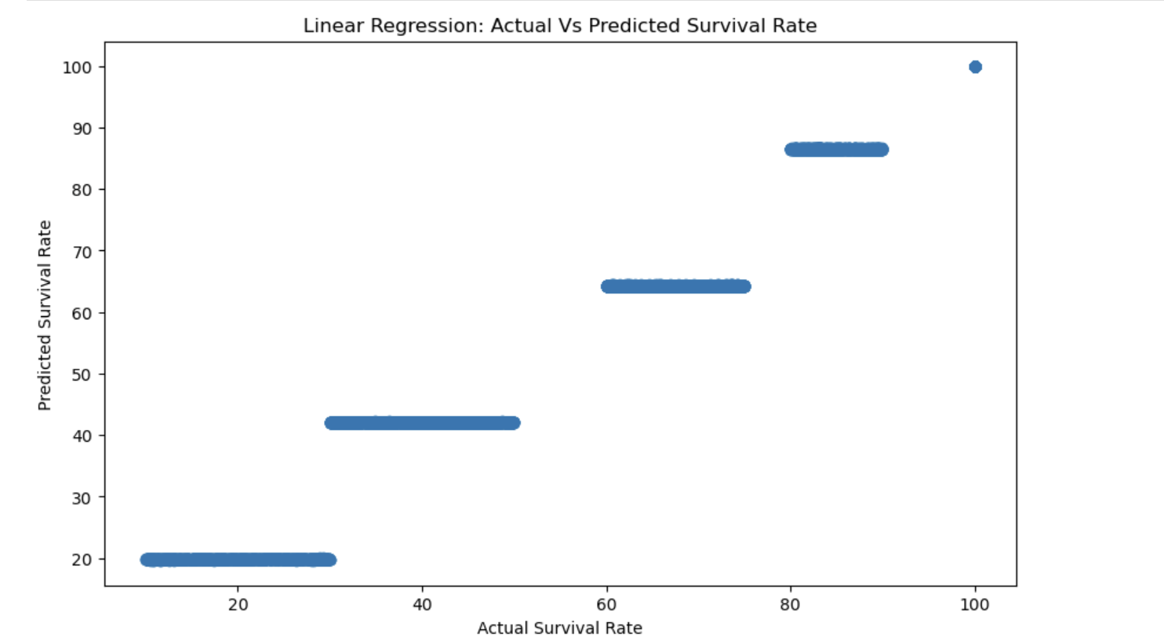
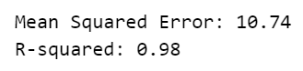
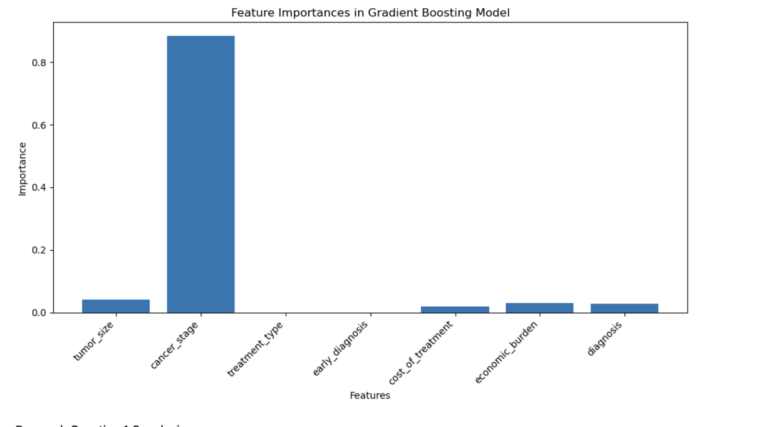
Regression Models
Linear Regression, Random Forest Regression, and Gradient Boosting Regression perform well, as evidenced by their high R-squared values of 0.98.
This suggests that 98% of the variance in the target variable is explained by the predictors in each model. A lower MSE indicates better predictive accuracy, as it suggests that the model’s predictions are closer to the actual values.
Gradient Boosting Regression is the best-performing model based on its lowest MSE – 10.74, meaning it makes the most accurate predictions with minimal errors.
While all models exhibit strong predictive power, Gradient Boosting’s iterative approach of correcting previous errors leads to improved performance over the others.
Therefore, Gradient Boosting Regression is the recommended model for making predictions on this dataset

Slide 13

To what extent do lifestyle factors (tobacco, alcohol, diet, sun exposure) influence tumor size and cancer stage?
Research Question 4

Slide 14
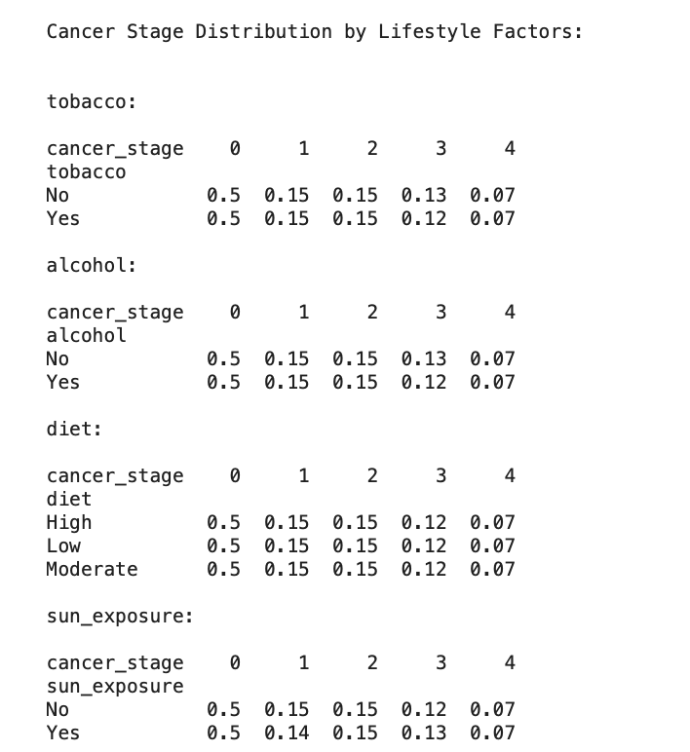
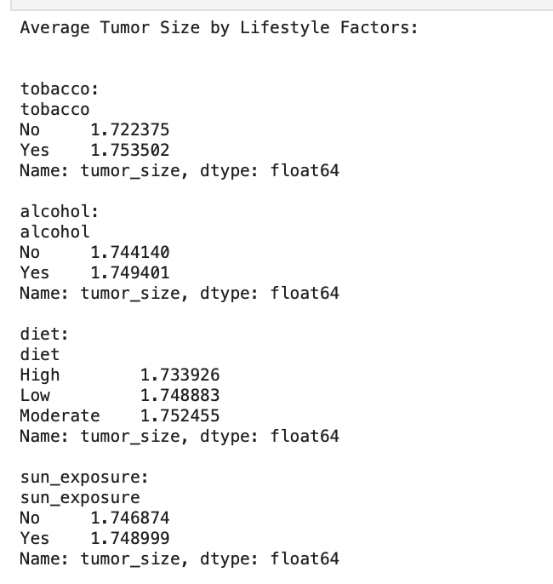
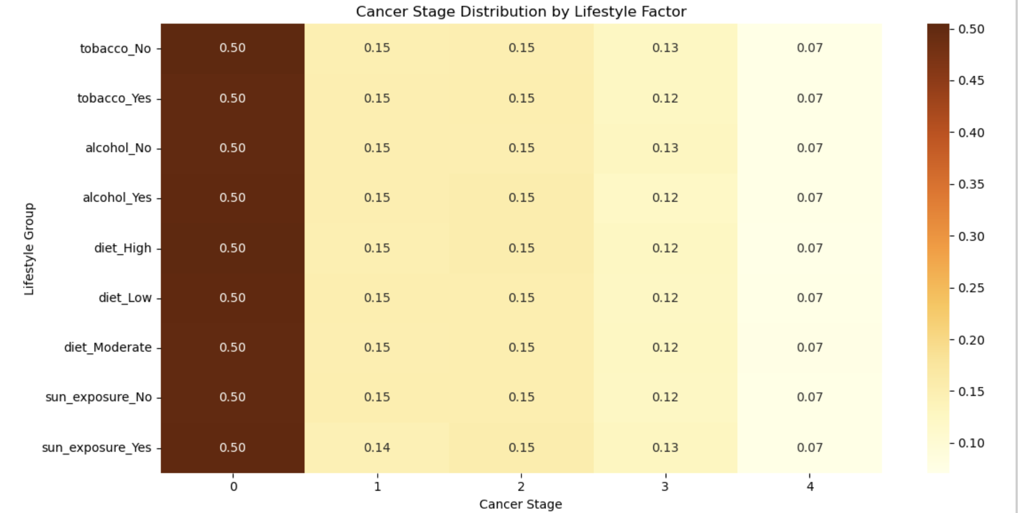
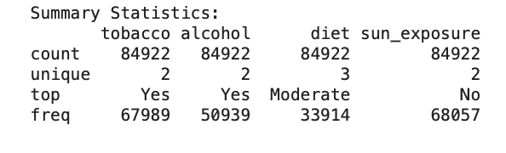
Descriptive Statistics

Slide 15
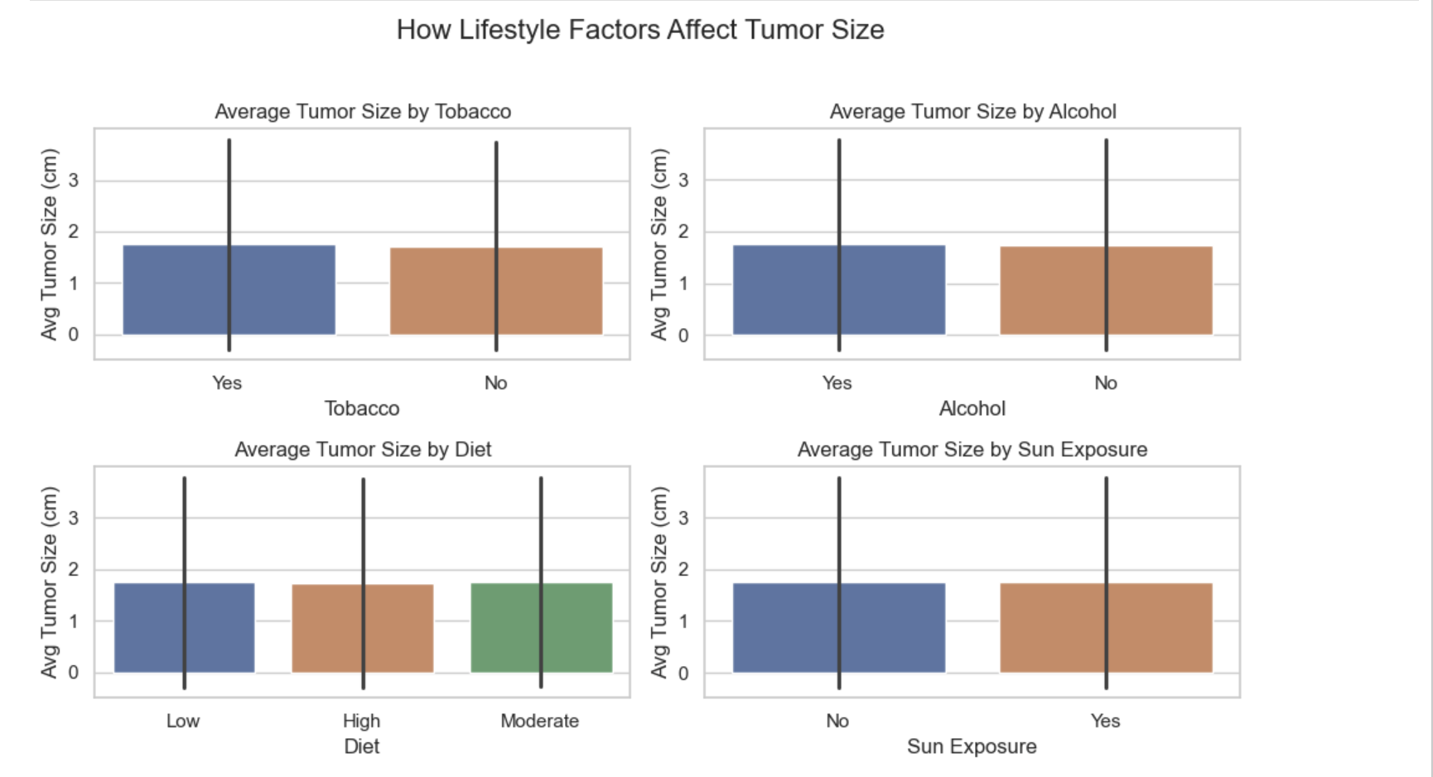
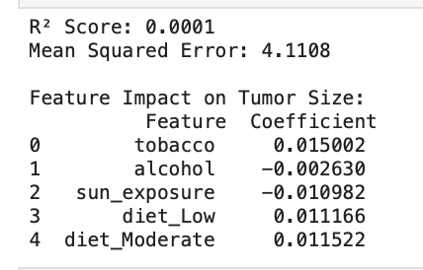
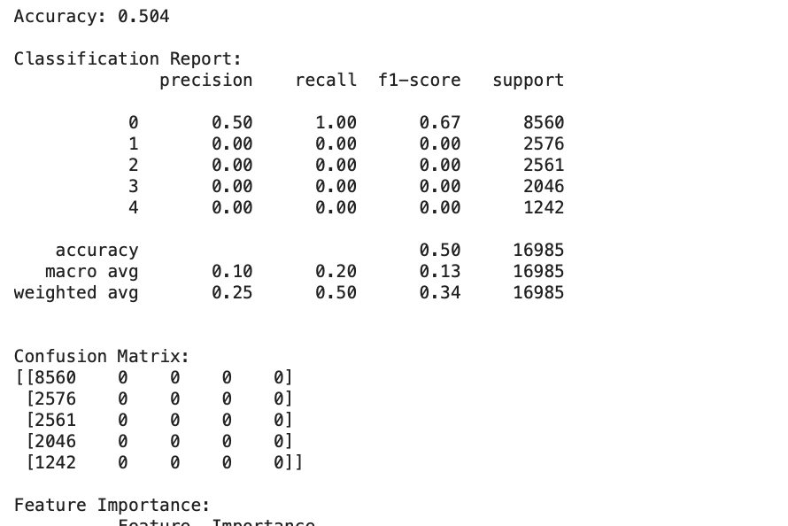
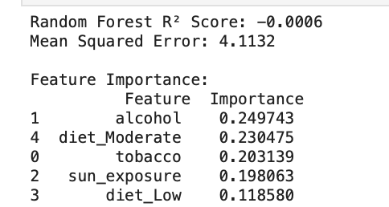
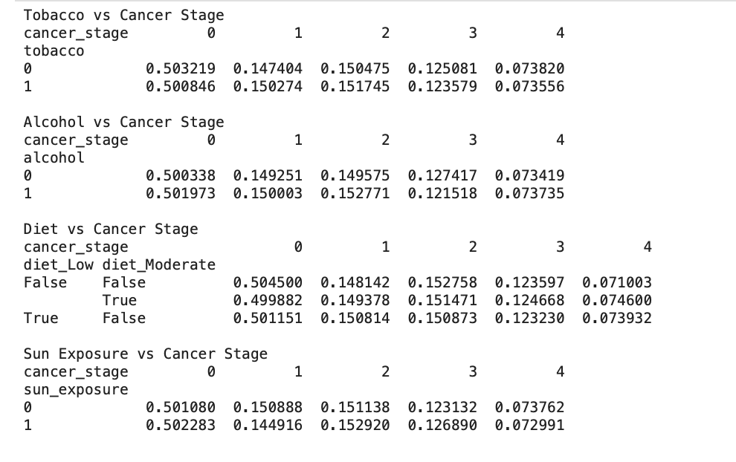
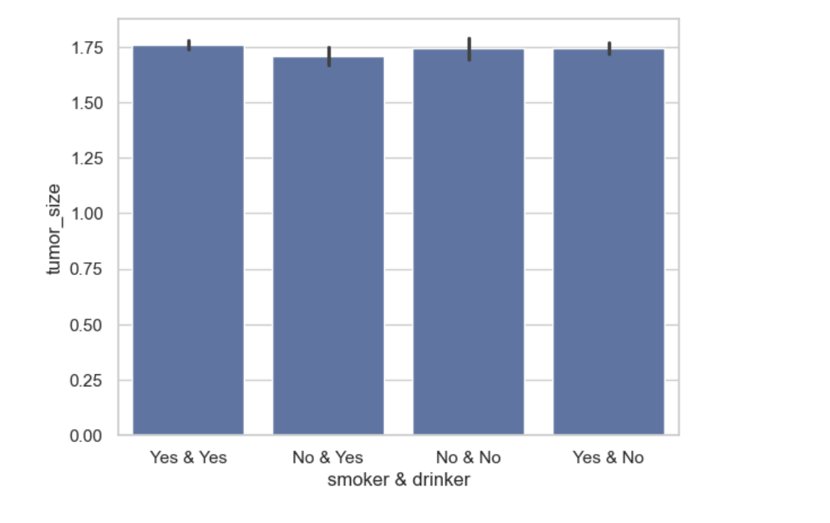
Data Visualization
Regression Model
Predictive Data Mining
Spreadsheet Model

Slide 16

What are the key factors influencing the cost of oral cancer treatment, and how does it vary across different patient groups?
Research Question 5

Slide 17
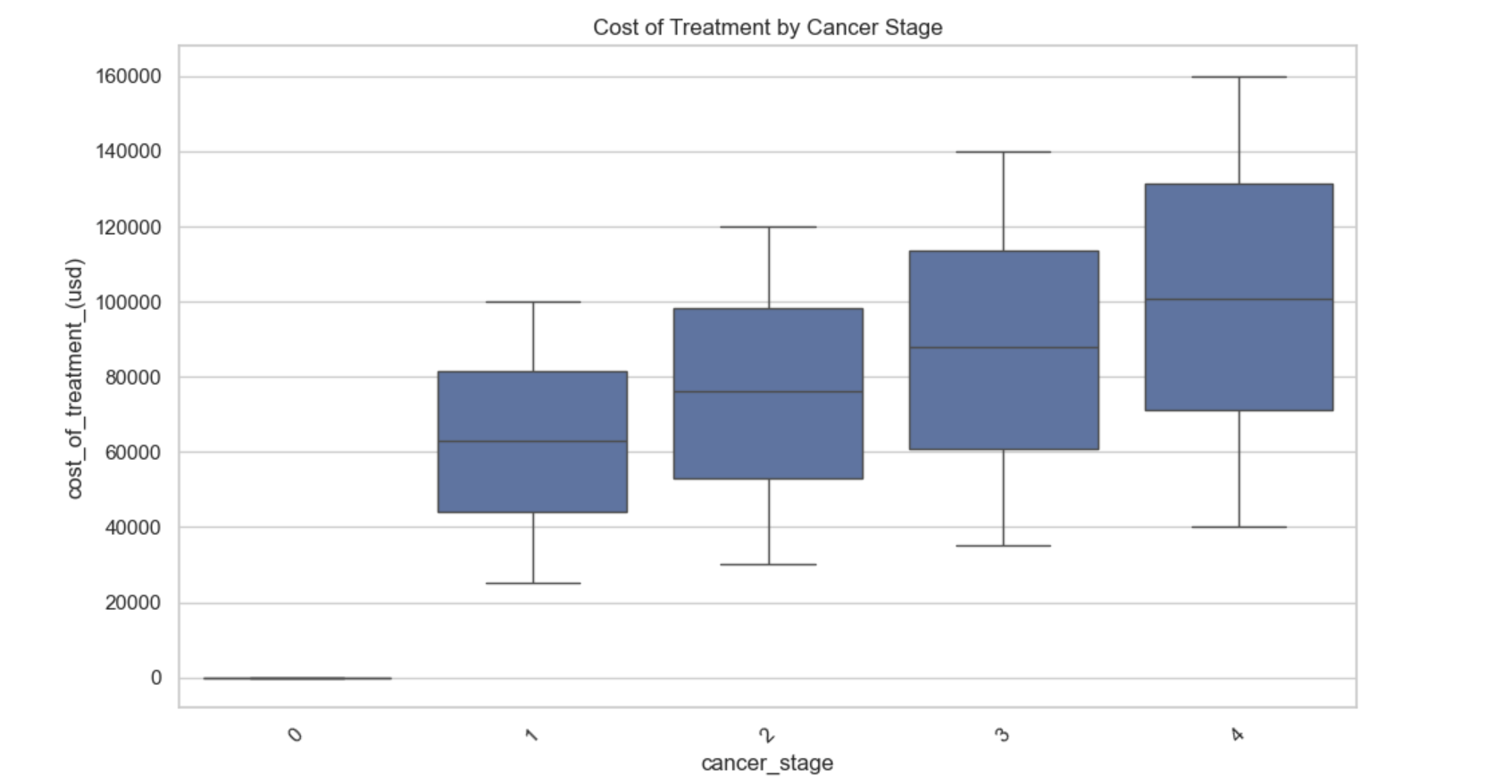
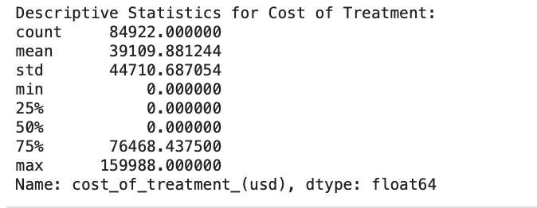
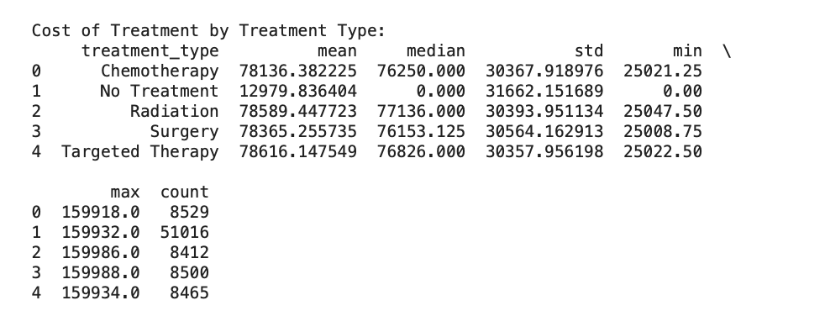
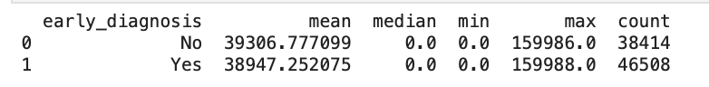
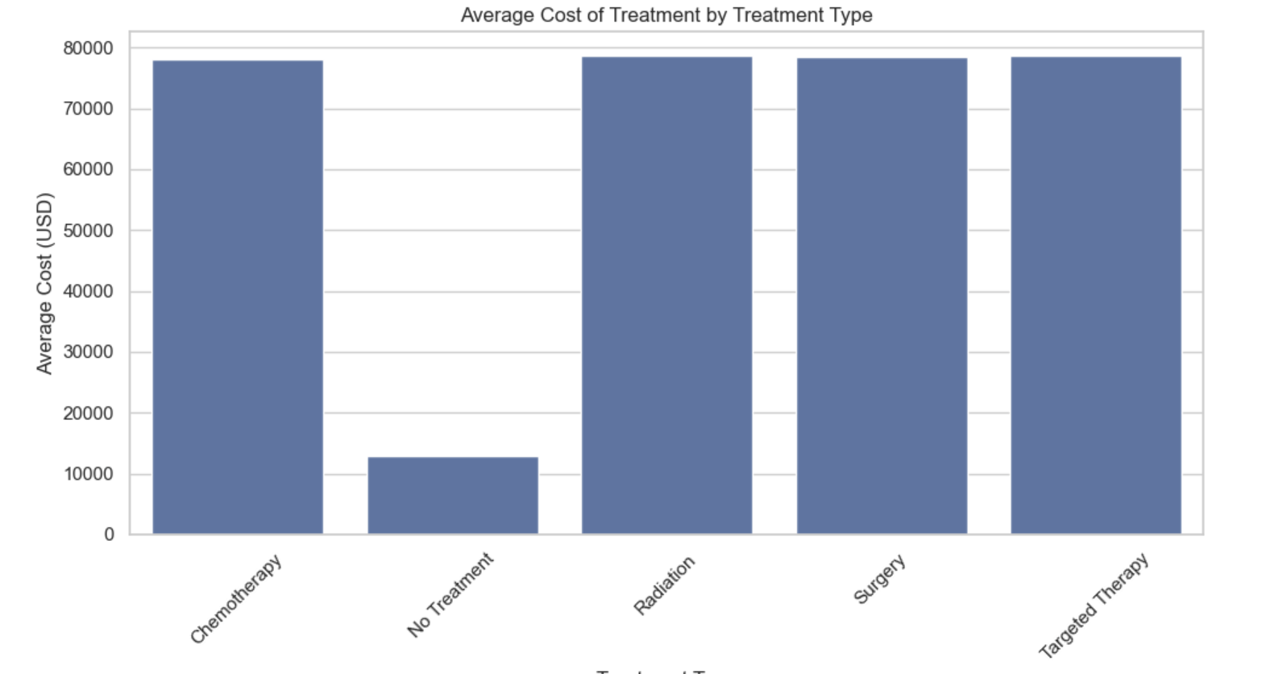
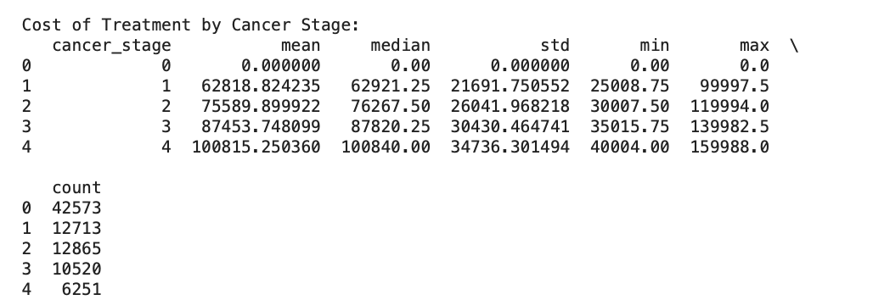
Descriptive Statistics
Data Visualization

Slide 18
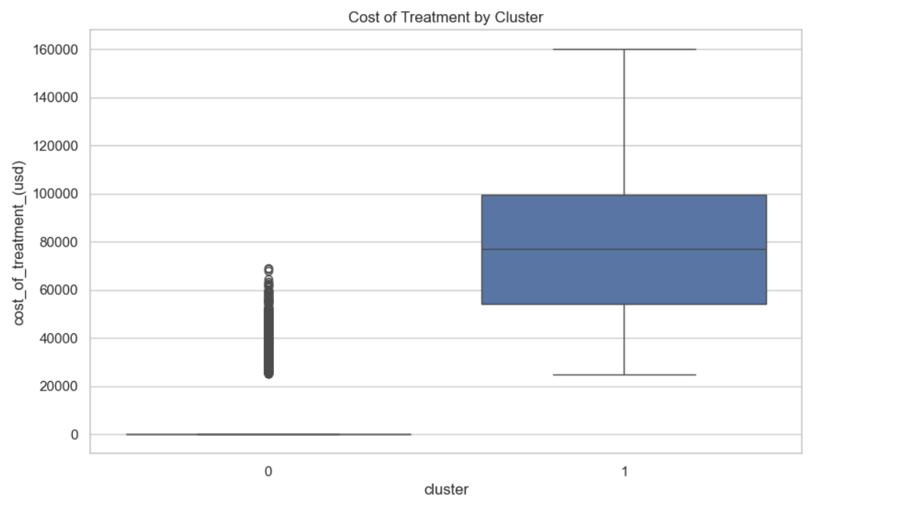
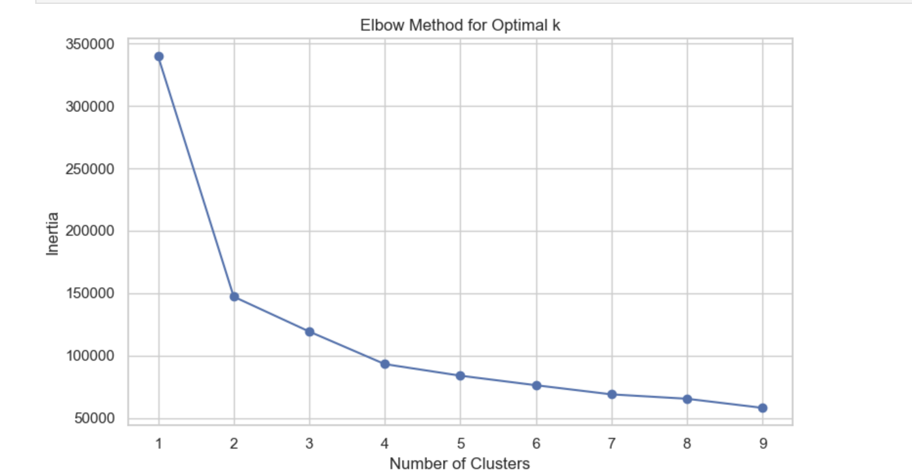

Descriptive Data Mining
Regression Model
Statistical Inference

Slide 19

Conclusion
This research paints a full circle view of the dynamics in oral cancer outcomes. It’s not just one factor, it’s an ecosystem.
Age and gender clearly play roles in diagnosis and survival patterns, while treatment choices significantly affect tumor progression, survival rates, and cost.
HPV status also emerged as a meaningful variable, suggesting biological drivers beneath the surface. Most importantly, early diagnosis consistently correlates with smaller tumor size, lower economic burden, and improved survival proving that timing is everything.
We recommend the need to champion early screening policies, push for affordable access to treatment, and integrate HPV testing into oral cancer checkups. Imagine what could change if high risk individuals were flagged and treated sooner.

Slide 20
RACI CHART
TASK | Description | LESLEY | OLUWATOSIN | RAYMOND | OLUWATOBILOBA | RUCHIT
Data Cleaning | Data Preprocessing and Cleaning | R | C | A | I | I
Question 1 | How do demographic factors influence the likelihood of developing oral cancer? | I | I | R | A | C
Question 2 | What are the most significant predictors of oral cancer diagnosis among the given risk factors? | A | C | I | R | A
Question 3 | How Do Early Diagnosis and Treatment Type Impact Survival Rates and Economic Burden Among Oral Cancer Patients? | R | I | A | C | I
Question 4 | To what extent do lifestyle factors (tobacco, alcohol, diet, sun exposure) influence tumor size and cancer stage? | I | R | A | C | I
Question 5 | What are the key factors influencing the cost of oral cancer treatment, and how does it vary across different patient groups? | C | A | I | C | R
PowerPoint | Preparing the PowerPoint Slides | A | R | C | I | I

